Slide 1




Cayucos Sustainable Water Project
Town Meeting

Slide 2
CAYUCOS TOWN MEETING
INTRODUCTIONS
REVIEW OF APRIL 2015 MEETING
PROJECT PROGRESS IN 2016
DRAFT EIR HIGHLIGHTS
PROJECT DELIVERY METHOD
INTRODUCTION of CMAR CONTRACTOR
PROJECT COSTS
PROJECT FINANCING - USDA
RATE INCREASE PROCESS – (PROP 218)

Slide 3
APRIL 2015 TOWN MEETING
PRELIMINARY COSTS
THEN
NOW
PLANNING/DESIGN/PERMIT
  $ 3 MILLION
CONSTRUCTION
  $18 MILLION
COMPLETION – 2018
PROPERTY ACQUISITION
MONTHLY RATE $104
PLANNING/DESIGN/PERMIT
  $ 3 MILLION
CONSTRUCTION
  $20 MILLION
COMPLETION
  ON SCHEDULE - 2018
PROPERTY BOUGHT
  $3.6 MILLION
MONTHLY RATE = ???

Slide 4
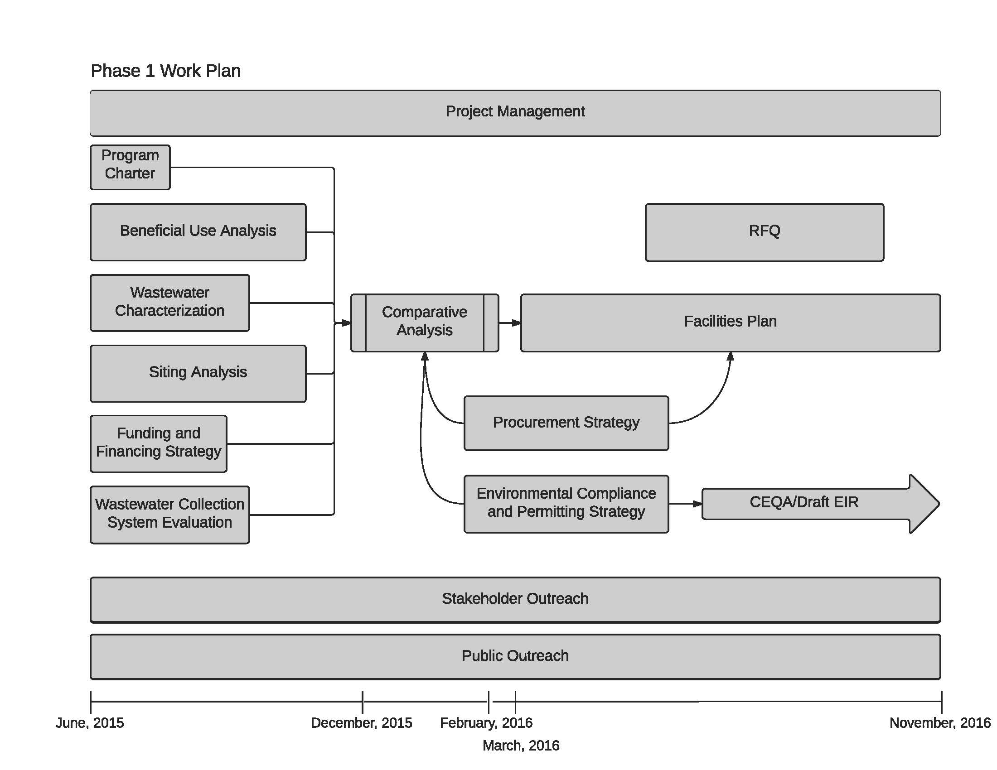

Slide 5
PROJECT PROGRESS IN 2016
APR - OPENED ESCROW ON TORO PROPERTY
JUNE - MBR TREATMENT TYPE WAS SELECTED
JULY - CLOSED ESCROW ON TORO PROPERTY
AUG - CMAR METHOD FOR PROJECT DELIVERY
SEPT - FILANC SELECTED AS CMAR
DESIGN/CONSTRUCTION CONTRACTOR

Slide 6
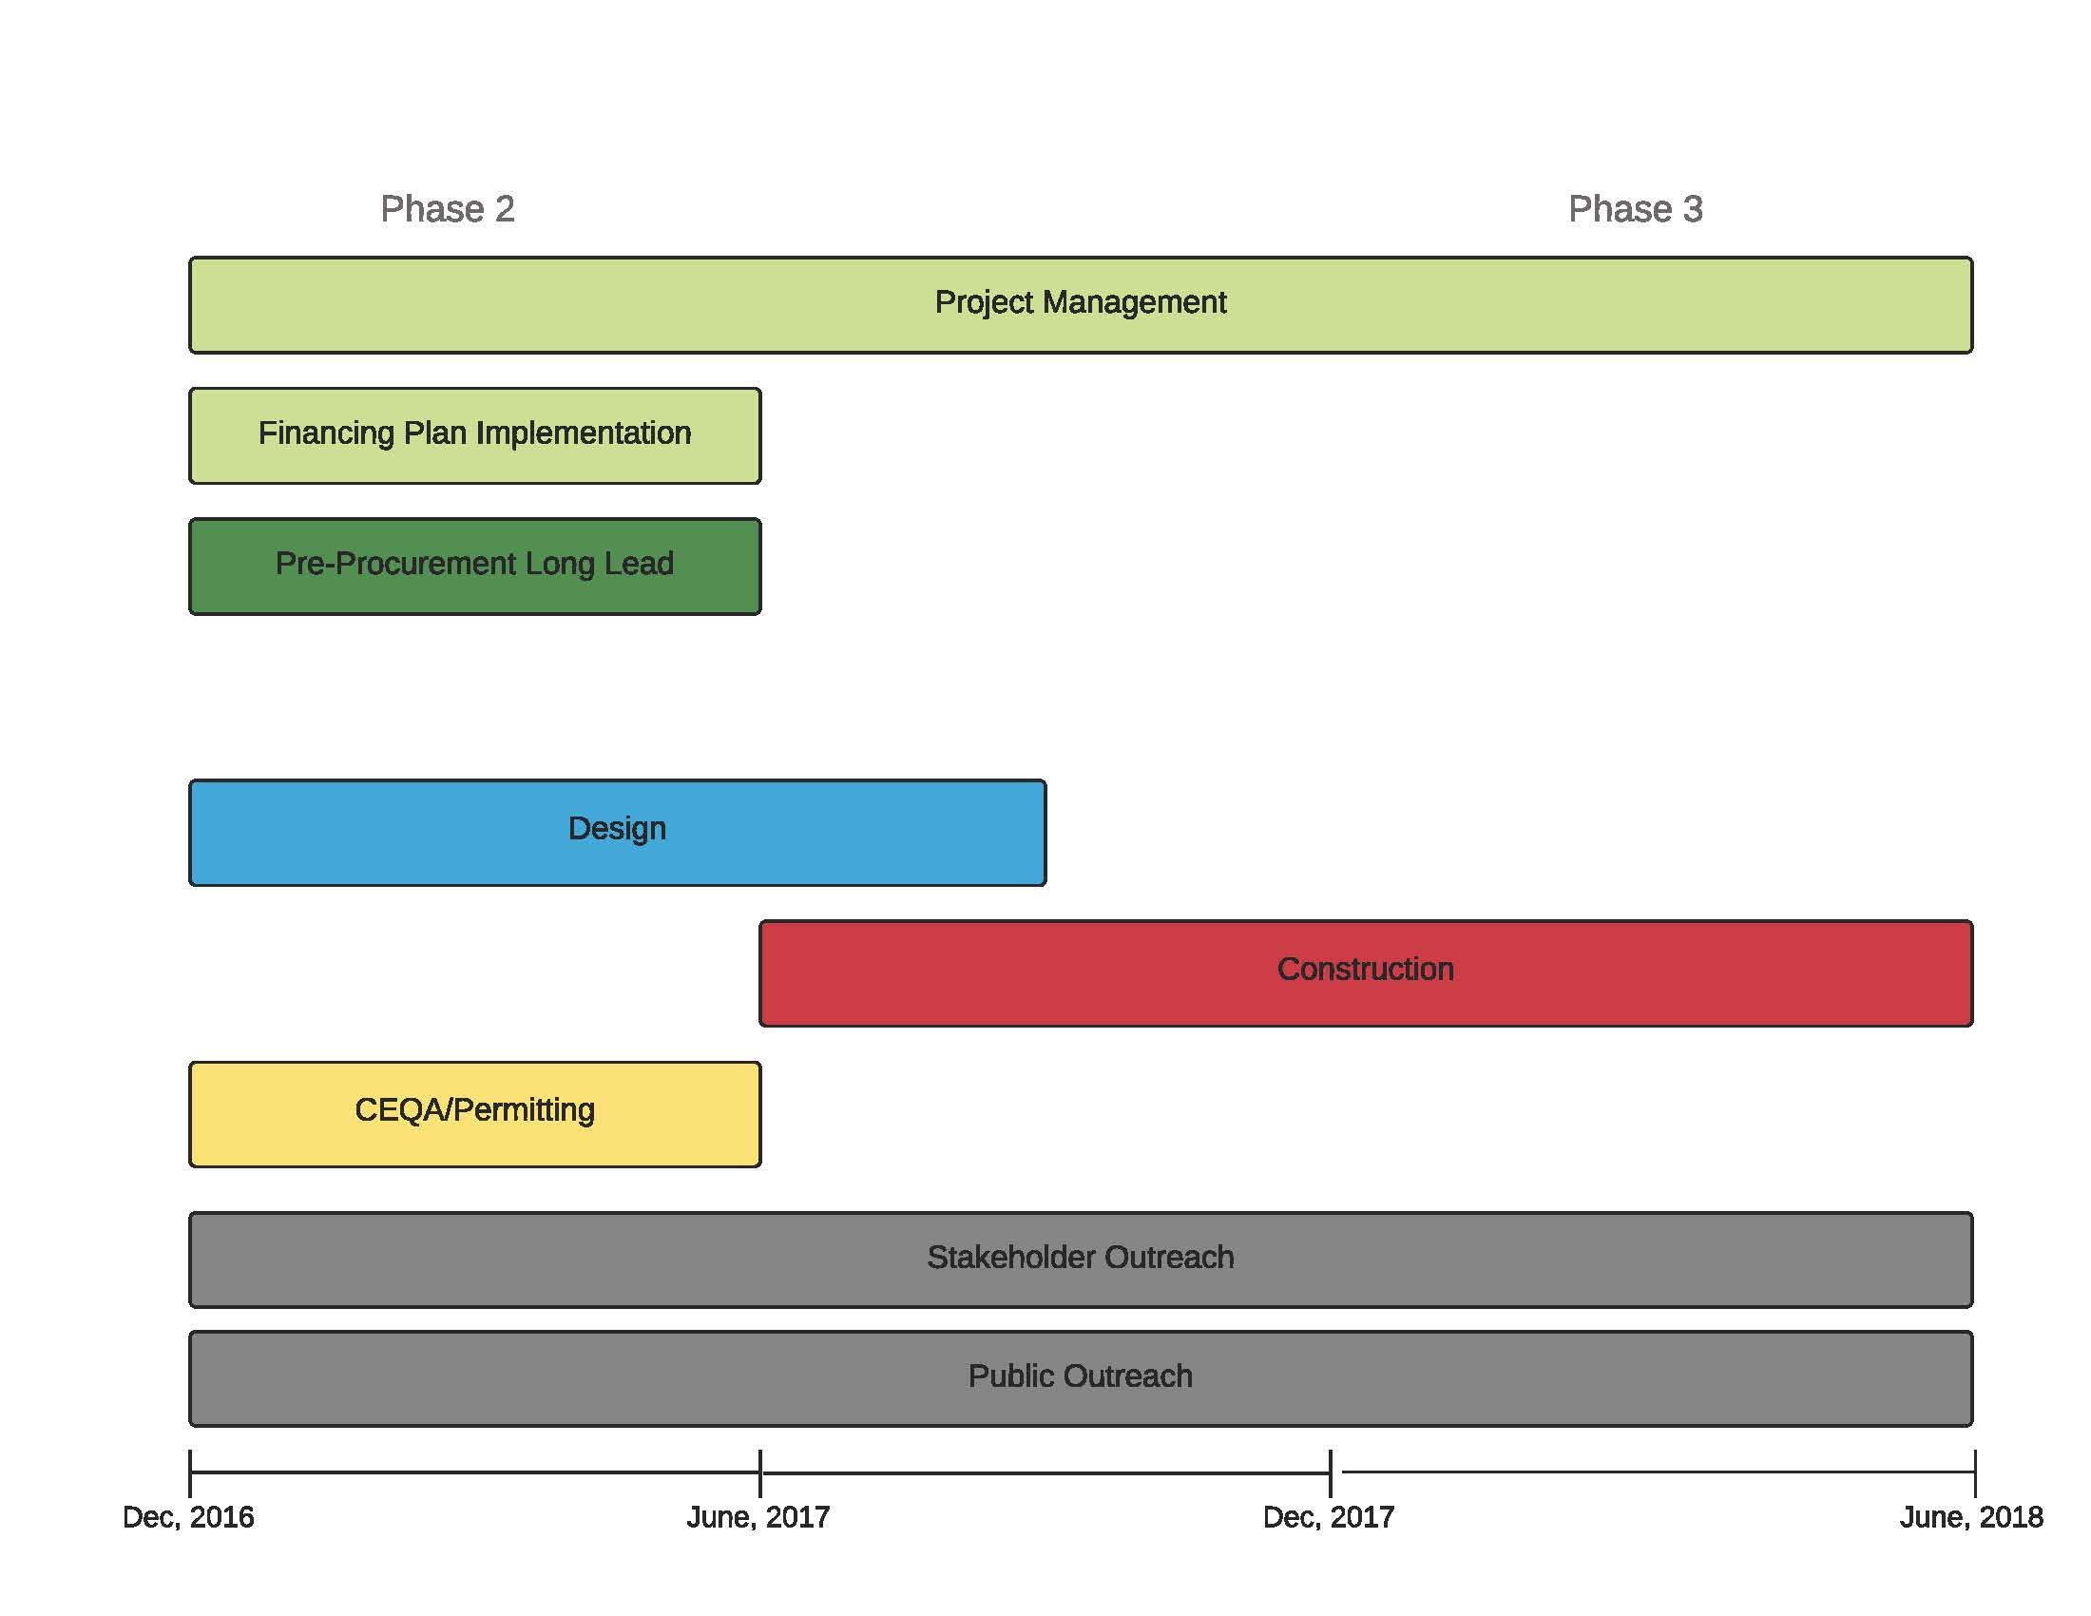

Slide 7
DRAFT EIR
HIGHLIGHTS

Slide 8
The CEQA Process
April 2016
  Initial Environmental Study and Notice of Preparation of the EIR was sent to Agencies.
  Notification of Project EIR to Native American groups pursuant to AB 52.
  Scoping meeting for public input
Ongoing communication with resource agencies, the County, Coastal Commission staff, Regional Water Board staff and Native American groups.
February 2017
  Draft EIR (DEIR) published for review and comment.

Slide 9
Significance of Environmental Impacts
The EIR makes a determination of impact significance based on established thresholds:
  Class IV - Beneficial Effects
  Class III - Impacts are Less than Significant and do not require Mitigation Measures.
  Class II - Impacts are Significant and require Mitigation Measures to reduce the impact to a less than significant level.
  Class I - Impacts are Significant, require Mitigation Measures, but are still at a significant level after all feasible mitigation is applied.

Slide 10
Types of Environmental Impacts
Class IV- Beneficial Effects
  The CSWP will have a beneficial effect on agriculture by creating tertiary treated water for irrigation.
  The CSWP would reduce energy compared to the existing condition and have a beneficial effect on greenhouse gas emissions.

Slide 11
Types of Environmental Impacts
Class III – Less than Significant, No Mitigation
  Biological resources
  Drainage and Stormwater
  Traffic
  Noise
  Air Quality
  Visual resources and Hazards

Slide 12
Types of Environmental Impacts
Class II – Impacts are Significant, Requires Mitigation
  Construction Activities
    Traffic
    Biological
    Cultural Resources
  Growth Inducing effects
    Reuse of water to limited to Ag or areas within the URL

Slide 13
Types of Environmental Impacts
Class I – Impacts are still at a Significant level even after feasible Mitigation
  Construction noise
    Temporary
  Agriculture resources
    2 acres dedicated to Ag use for every 1 acre disturbed

Slide 14
Next Steps
February 2017
  DEIR available for 45 day, agency and public comment
End of March 2017
  DEIR Comments due
District will prepare a Final EIR (FEIR) with response to all comments
April 2017
  District Board of Directors will hold a public hearing to certify FEIR.
The County will use the District’s FEIR for the permitting process.
DEIR available on District website www.cayucossd.org

Slide 15
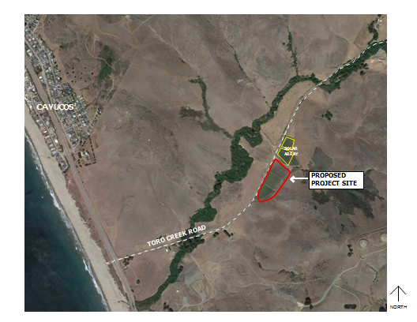
The Proposed CSWP facility

Slide 16
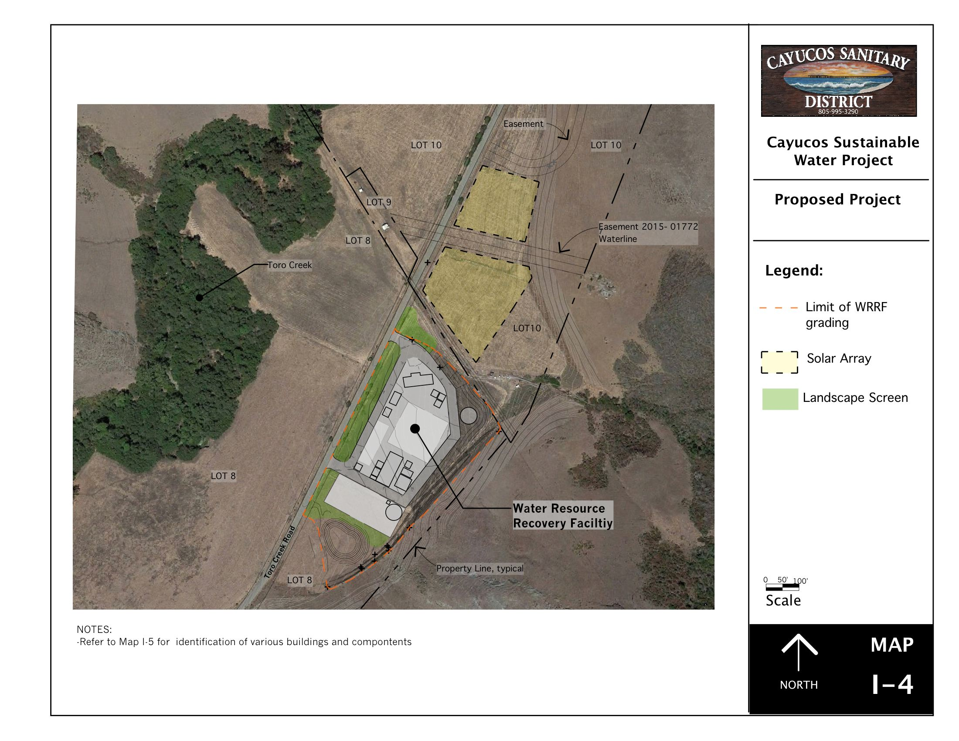
The Proposed CSWP facility

Slide 17
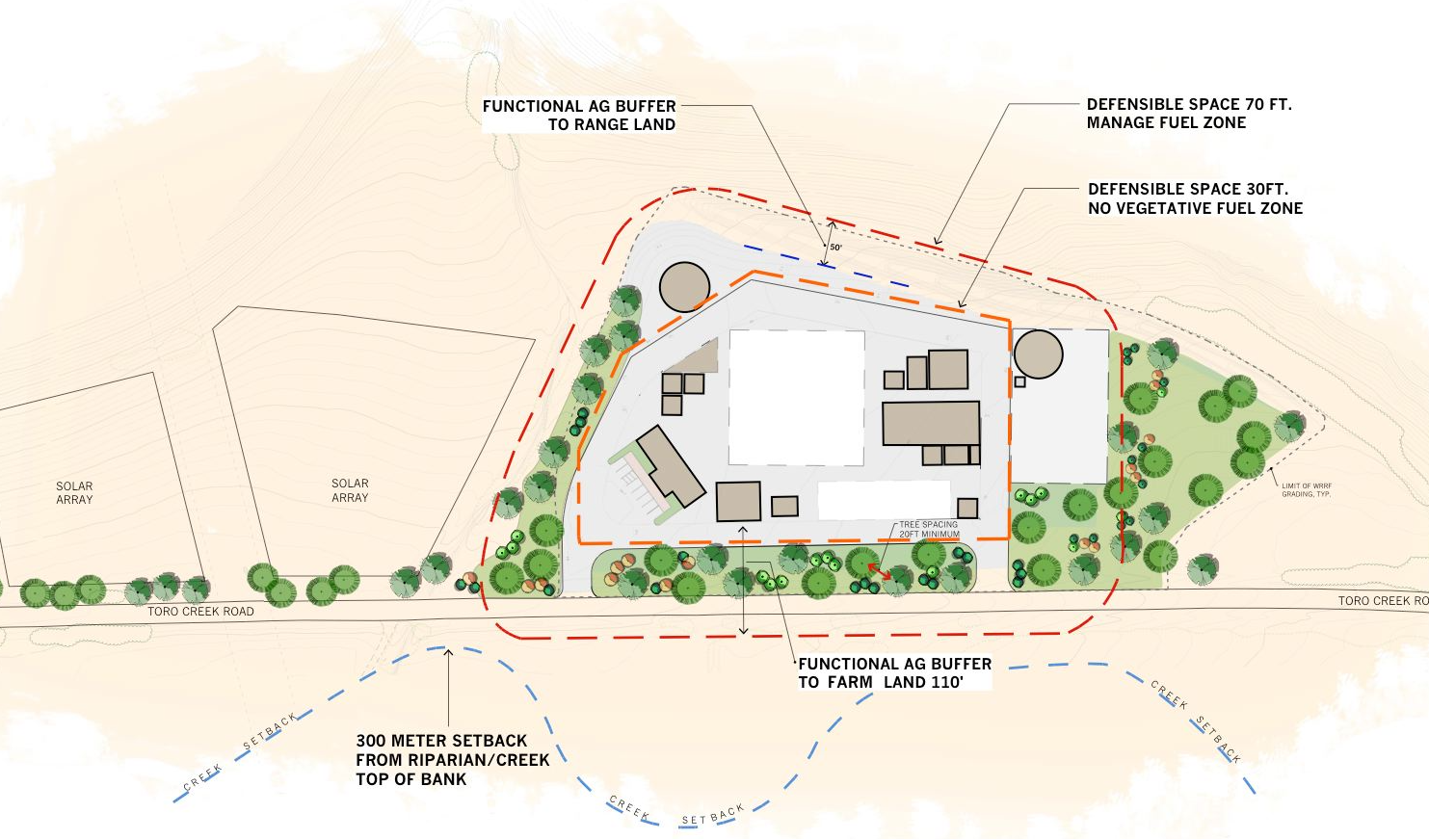
The Proposed CSWP facility

Slide 18
PROJECT DELIVERY METHOD
LOW BID - Traditional
  Change Orders
  High Contingencies
DESIGN-BID-BUILD
  Owner has no Oversite
CONSTRUCTION MANAGER AT RISK (CMAR)
  Owner, Designer, CMAR Work Cooperatively
  Owner approves a Guaranteed Maximum Price - GMP
  Minimal Changes During Construction

Slide 19
Benefits of CMAR
All on the same team:
  Value added collaboration of design and construction
  Early problem identification
  Early budget information
  Advance schedule planning
  Advance procurement planning
  Minimize construction change orders
  Guaranteed Maximum Price

Slide 20
Two Phases of CMAR
Preconstruction
Construction
Value Engineering of design, conceptual estimating
Constructability review of design
Technology selection and procurement planning
Scheduling
Guaranteed Maximum Price (GMP) for construction
Mobilization
Procurement
Subcontracting
Construction Management
  Schedule and Budget
Completion
  Startup and Commissioning
  Operations Training
  Warranty Period

Slide 21
INTRODUCTION OF CMAR
CONTRACTOR

Slide 22
FILANC: Building it Better Together
Family owned California General Contractor since 1952
Specializing in water & wastewater construction
Self-performing & use of local contracting
CMAR contractor since 2002
Design-builder since 1980s

Slide 23
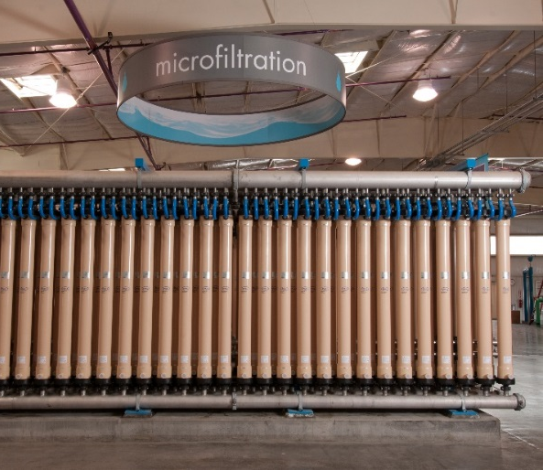
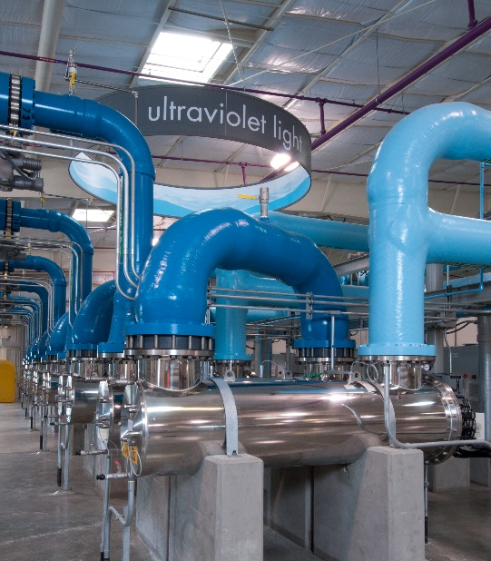
Building and Commissioning Complex Treatment Facilities
Silicon Valley Advanced Water Purification Facility
Irvine Ranch Water District Michelson MBR and Biosolids Upgrades
City of Modesto Phase II MBR facility

Slide 24
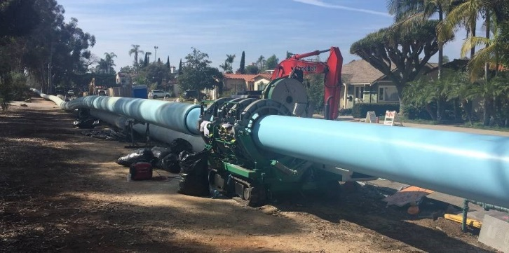
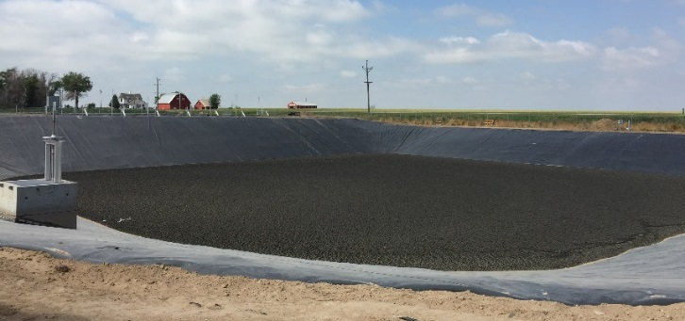
Filanc as CMAR
15 years of experience as CMAR on over $150 million of projects in Arizona, California and Colorado
  City of Yuma, Agua Viva Water Treatment Plant, $92M
  City of San Diego, Upas Street Potable Water Pipeline, $28.5 M
  City of Phoenix, Water Treatment Plant Upgrades, $30 M
  Town of Ault Colorado Wastewater Treatment Plant Improvements, $3.5 M

Slide 25
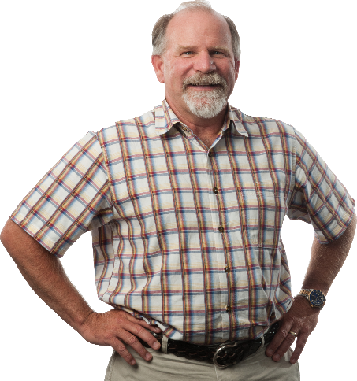
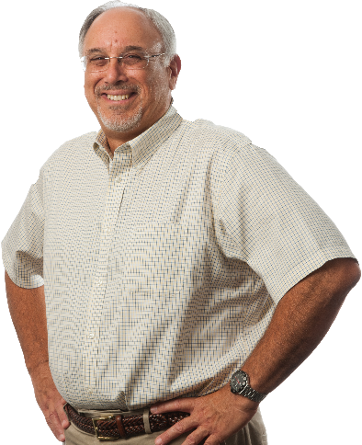
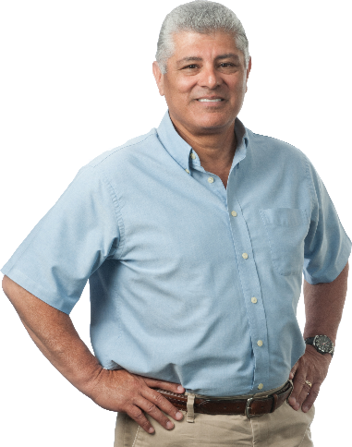
Value Engineering & Constructability: Combined 125 years of experience
Mark Filanc, PE, DBIA
Chief Executive Officer
Harry Cosmos
President
Vince Diaz
Vice President, Construction

Slide 26
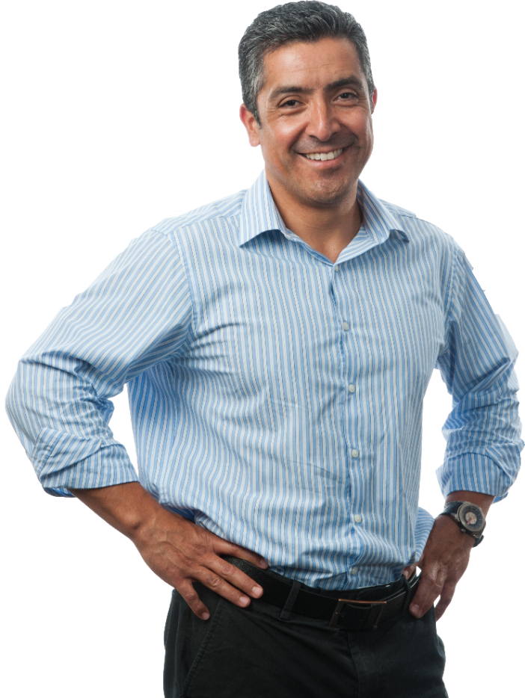
Preconstruction Services Team
Manager: Omar Rodea, PE, DBIA
  20+ years of experience
  Leads performance of value engineering and constructability reviews
  Develops conceptual, planning level and baseline schedules
  Coordinates with Filanc estimating staff
  Maintains continuity throughout the life cycle of this project

Slide 27
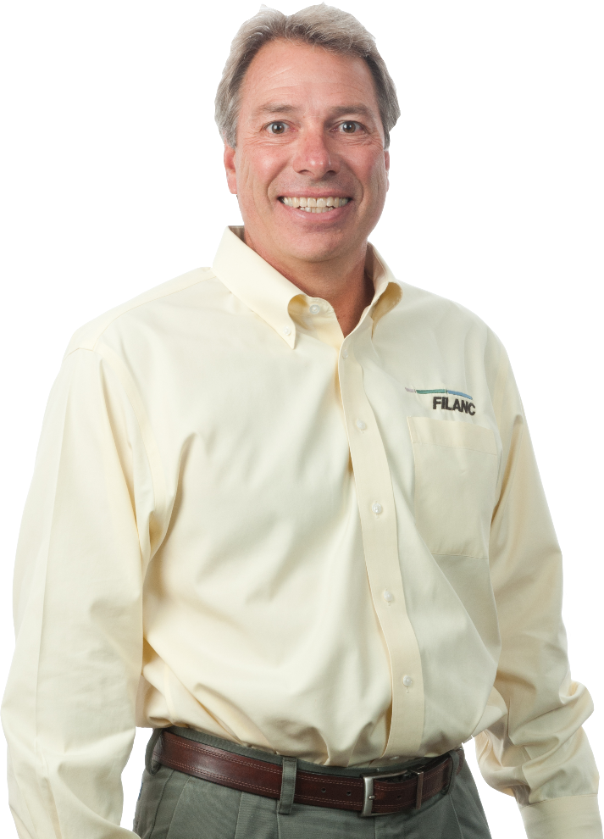
Process equipment procurement:
Bob Zaiser
Experience as OEM Representative
Unmatched understanding of vendor specifications and unique requirements
Best value process equipment recommendations
Design support

Slide 28
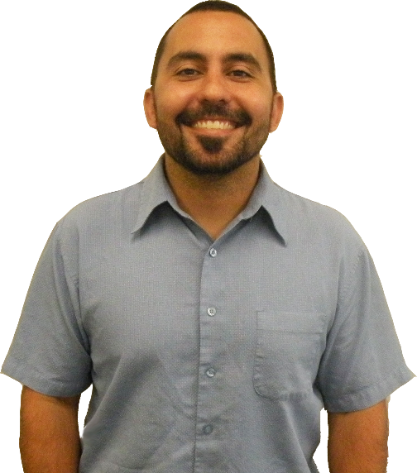
Estimating to Deliver Cost Certainty
Lead Estimator, Tony Ruiz
  More than 10 years of estimating and CMAR GMP experience
  Performs conceptual estimating during design
  Prepares vendor bid specification packages
  Prepares subcontractor bid packages
  Develops draft and final GMP proposals

Slide 29
CMAR Maximizes Value of Investment
Team collaboration will ensure that quality is affordably built into the design
Design and Construction collaboration from start to finish will ensure a smooth process
Price certainty will be achieved early
Change orders will be minimized
An aggressive schedule will be met

Slide 30
Building it Better Together

Slide 31
TREATMENT FACILITY COSTS
ENGINEERS ESTIMATE = $ 21 M
PRELIM CMAR ESTIMATE = $ 20 M
PLANNING/DESIGN/PERMIT = $ 3 M
TOTAL LOAN = $ 23 M
to $25 M

Slide 32
PROJECT FINANCING
RECEIVED
  SWRCB PLANNING GRANT $75,000
APPLIED
  SRF NOT AVAILABLE UNTIL 2018/2019
PURSUING
  USDA RURAL COMMUNITIES PROGRAM
  USDA GRANTS

Slide 33

Water & Waste Disposal Loan & Grant Program
Program 101
What does this program do?
Provides funding for clean and reliable drinking water systems . sanitary sewage disposal. sanitary solid waste disposal. and storm water drainage to households and businesses in eligible rural areas.
Who may apply?
This program assists qualified applicants that are not otherwise able to obtain commercial credit on reasonable terms. Eligible applicants include:
Most State and Local governmental entities
Private non-profits
Federally-recognized Tribes
What is an eligible area?
Are that may be served include:
Rural areas and towns with fewer than 10.000 people
Tribal Lands in rural areas
Colonias
What kinds of funding are available?
Long-term. Low-interest Loans
If funds are available. grants may be combined with a Loan if necessary to keep user costs reasonable

Slide 34
How may the funds be used?
Funds may be used to finance the acquisition, construction or improvement of:
Drinking water sourcing, treatment. storage and distribution
Sewer collection, transmission, treatment and disposal
Solid waste collection. disposal and closure
Storm water collection. transmission and disposal
In some cases. funding may also be available for related activities such as:
Legal and engineering fees
Land acquisition. water and Land rights. permits and equipment
Start-up operations and maintenance
Interest incurred during construction
Purchase of existing facilities to improve service or prevent Loss of service
Other costs determined to be necessary for completion of the project
For a complete List. see 7 CFR Part 1780.7 and 1780.9
What is the loan term and rate?
Up to 40-year payback period, based on the useful Life of the facilities financed
Fixed interest rate
The interest rate is based on the need for the project and the median household income of the area to be served. (currently @ 2.75%)
Contact us for details and current interest rates applicable for your project
Are there additional requirements?
Borrowers must have the Legal authority to construct. operate and maintain the proposed services or facilities
ALL facilities receiving federal financing must be used for a public purpose
Partnerships with other federal. state. Local. private and non-profit entities that offer financial assistance are encouraged
Projects must be financially sustainable

Slide 35
RATE INCREASE PROCESS
PROPOSITION 218

Slide 36
RATE STRUCTURE
Current Rate (1 EDU/MO)
  O&M EXPENSES $12.88
  EXISTING DEP $13.18
  WWTP OPS $18.71
  RESERVES $ 7.23
  TOTAL $ 52
Future Rate (1 EDU/MO)
  O&M EXPENSES $12.88
  EXISTING DEP $13.18
  WWTP OPS $18.71
  RESERVES $ 7.23
  LOAN PAYBACK $29.55
  PLANT DEP 40yr $16.45
  TOTAL $ 98

Slide 37
PROPOSED RATE SCHEDULE
(phased over 5 years)
Proposed Increase Monthly Bill (per EDU)
July 2017 + $15 $ 67
July 2018 + $15 * $ 82
July 2019 + $ 6 $ 88
July 2020 + $ 6 $ 94
July 2021 + $ 4 $ 98
* 1ST Loan Payment Due at end of Construction - 2018

Slide 38
218 PROCESS
February 16TH - District Board Authorizes 218
February 23RD - Notification Mailers sent
45 Day Response Period
April 20TH - District Board 218 Hearing
  Majority of Owners must protest for rate increase to fail

Slide 39
QUESTIONS
COMMENTS

