Slide 1
CAYUCOS TOWN MEETING
BUSINESS RELATIONSHIP BETWEEN CSD AND CMB
CURRENT BUSINESS RELATIONSHIP
FUTURE BUSINESS RELATIONSHIP AS PROPOSED BY CMB
ALTERNATE SITE HISTORY
PRELIMINARY COSTS
CSD FACILITY vs NEW CMB FACILITY
EFFECT ON MONTHLY RATES
LOOKING FORWARD
COMMUNITY SUSTAINABILITY
OWNERSHIP
LOCAL GOVERNANCE

Slide 2
CURRENT BUSINESS RELATIONSHIP
JPA – JOINT POWERS AGREEMENT
% OWNERSHIP
LAND = 60% CMB / 40% CSD
CAPACITY = 65% CMB / 35% CSD
OUTFALL = 65% CMB / 35% CSD
EQUAL VOTING… 50 / 50
FUTURE MODIFCATIONS, REPLACEMENTS AND ENLARGEMENTS
NO RELOCATION, RECONSTRUCTION, ALTERATION TO, ADDITION TO OR REPLACEMENT OF ANY PORTIONS OF THE WASTEWATER TREATMENT PLANT SHALL OCCUR WITHOUT THE PRIOR WRITTEN APPROVAL BY MORRO BAY AND CAYUCOS.
UNLESS OTHERWISE AGREED TO BY THE PARTIES, THE COST OF SUCH AN AGREED TO RECONSTRUCTED PLANT WILL BE ALLOCATED BASED UPON THE CAPACITY RIGHTS AGREED TO AT THE TIME OF RECONSTRUCTION.

Slide 3
FUTURE BUSINESS RELATIONSHIP
PROPOSED CMB MOU
REIMBURSEMENT TO CMB FOR THEIR STUDIES SINCE JAN 2013
% OWNERSHIP
LAND = 100% CMB
FACILITY AND CAPACITY = 100% CMB
TREATED EFFLUENT = 100% CMB
28% CAPITAL COST CONTRIBUTION BY CSD WITH NO EQUITY
NO VOTING – CSD INPUT JUST “ADVISORY”
CMB HAS FINAL DECISION ON DEVELOPMENT AND CONSTRUCTION PROCESS
CSD SUBJECT TO CMB DEFINED RATES WITHOUT OVERSIGHT

Slide 4
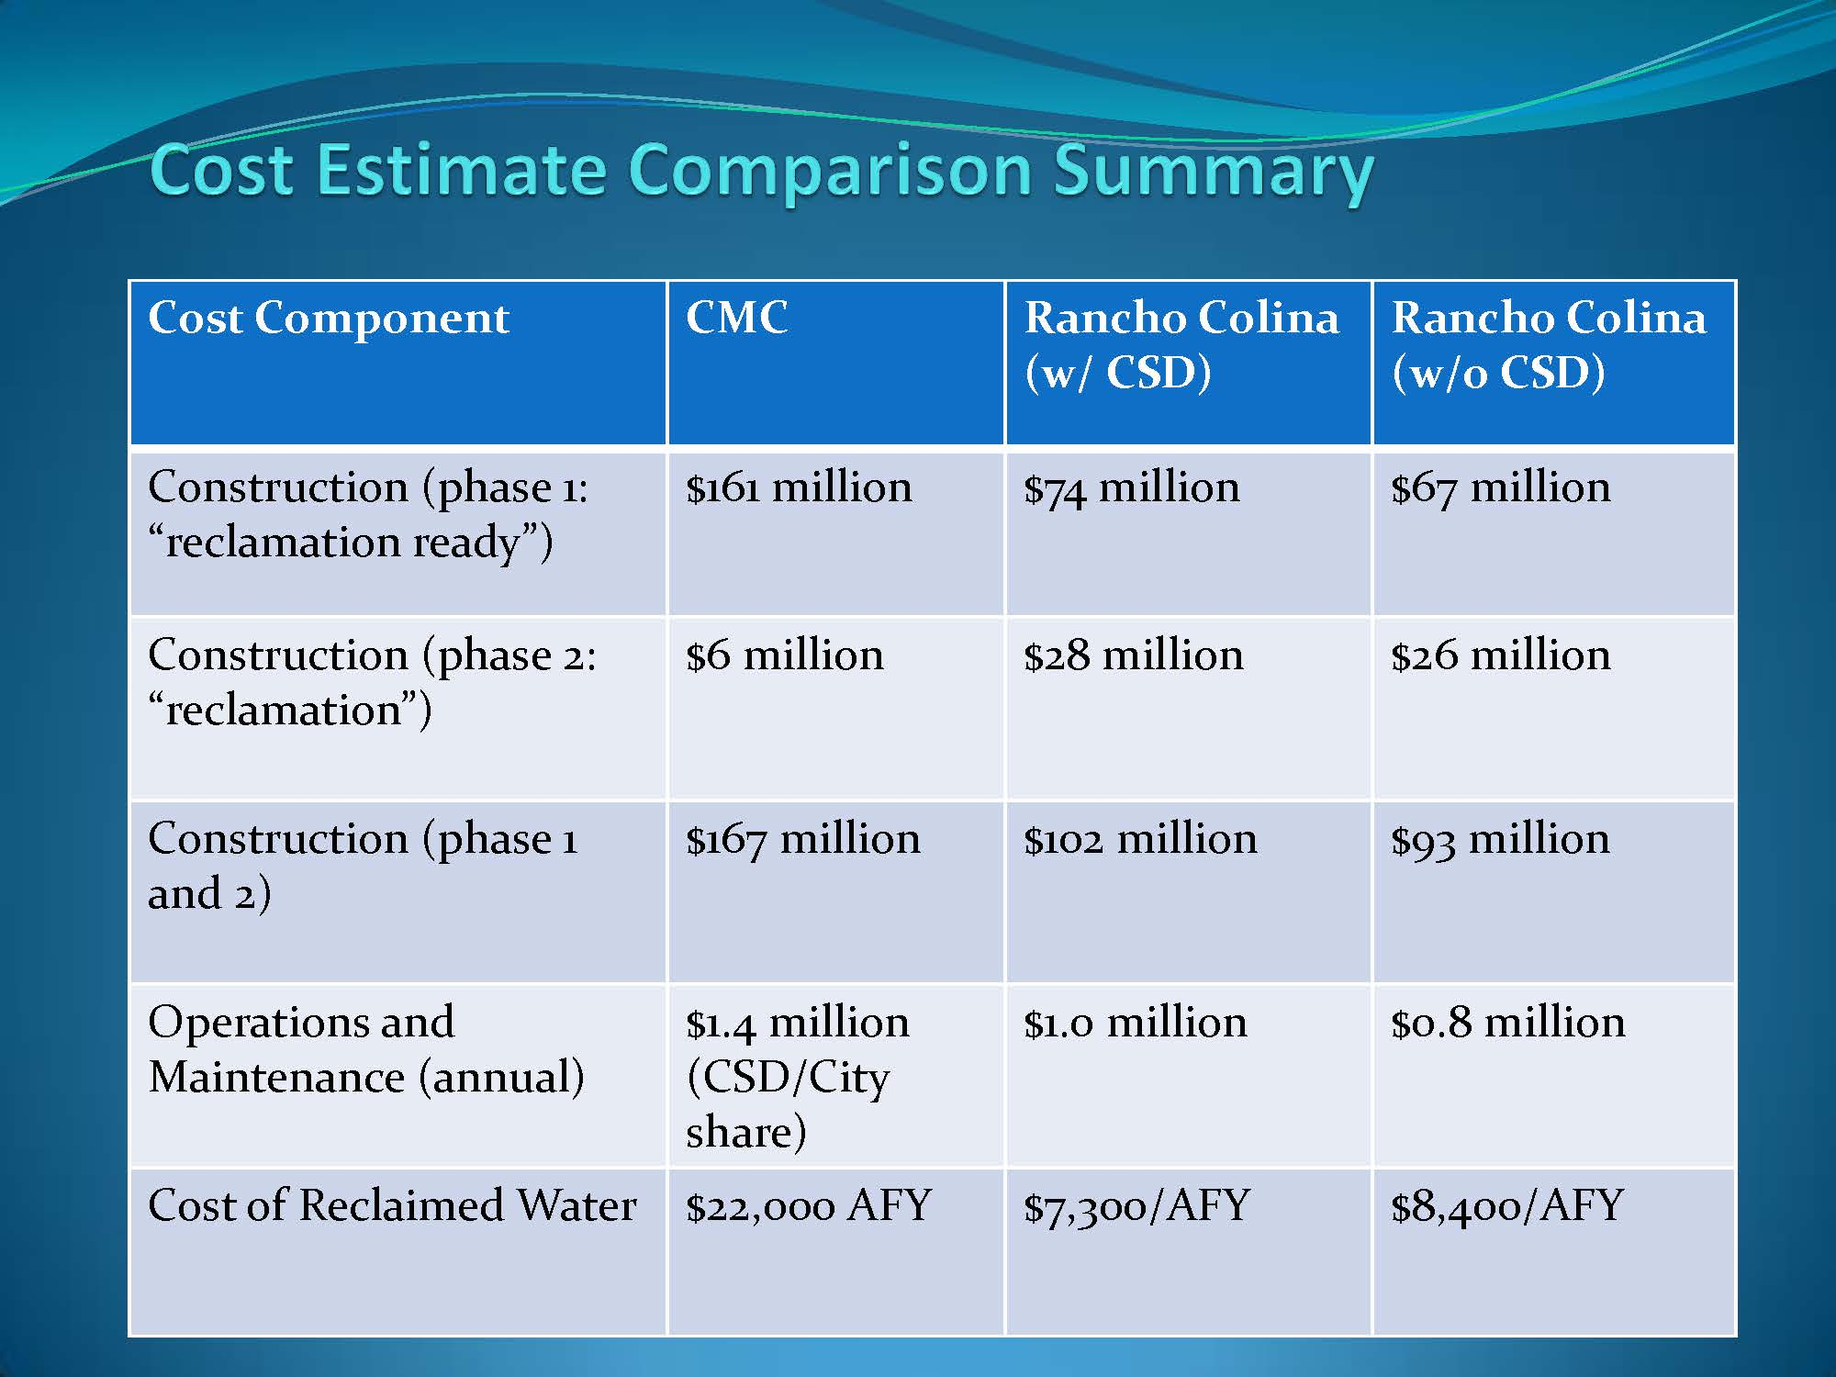
ALTERNATE SITE HISTORY

Slide 5
PRELIMINARY COSTS CSD vs CMB
CSD FACILITY
CMB FACILITY
PLANNING/PERMITTING
$ 2 MILLION
CONSTRUCTION
$18 MILLION
CSD PORTION = $20 MILLION
COMPLETION – 36 MONTHS
NOT INCLUDED
PROJECT MANAGEMENT
PROPERTY ACQUISITION
ADVANCED WATER TREATMENT
MONTHLY RATE $104
PLANNING/PERMITTING
$ 4.7 MILLION (CSD&CMB)
CONSTRUCTION
$ 74 MILLION (CSD&CMB)
CSD PORTION = $22 MILLION
COMPLETION – 48+ MONTHS
NOT INCLUDED
PROJECT MANAGEMENT
PROPERTY ACQUISITION
ADVANCED WATER TREATMENT
( CMB ESTIMATE = $28 MILLION )
GETTING THE TREATED EFFLUENT BACK TO CAYUCOS
MONTHLY RATE $104++

Slide 6
CAYUCOS LOOKING FORWARD
COMMUNITY SUSTAINABILITY
INDIRECT POTABLE REUSE
REVITALIZE AGRICULTURE
PARKS, OPENSPACE USE
SALT WATER BUFFER
DIRECT POTABLE REUSE
SURFACE WATER AUGMENTATION
POTABLE WATER SYSTEM
OWNERSHIP
LAND = 100% CSD
FACILITY AND CAPACITY = 100% CSD
TREATED EFFLUENT = 100% CSD
LOCAL GOVERNANCE
TREATED EFFLUENT
OPERATIONAL COSTS
MONTHLY RATE

